Slide 1
Olin Electric Motorsports
Olin College of Engineering
Team #236

Slide 2
Suspension
Olin College of Engineering

Slide 3
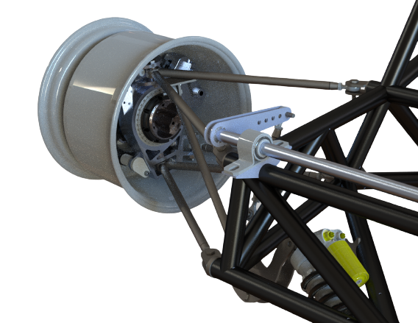
Overview & Concept of Operations
Olin College of Engineering
Design Optimization
Created MATLAB script to determine suspension nodes for given characteristics
Uprights
Designed to be lightweight and allow for adjustment with shims
Sent out to DATRON for fabrication
Linkages and ARBs
Necessary cutting and welding performed in-house
Rod ends/lever arms allow for adjustability
ARB Lever Arms
ARB
Front Knuckle
Front Rocker

Slide 4
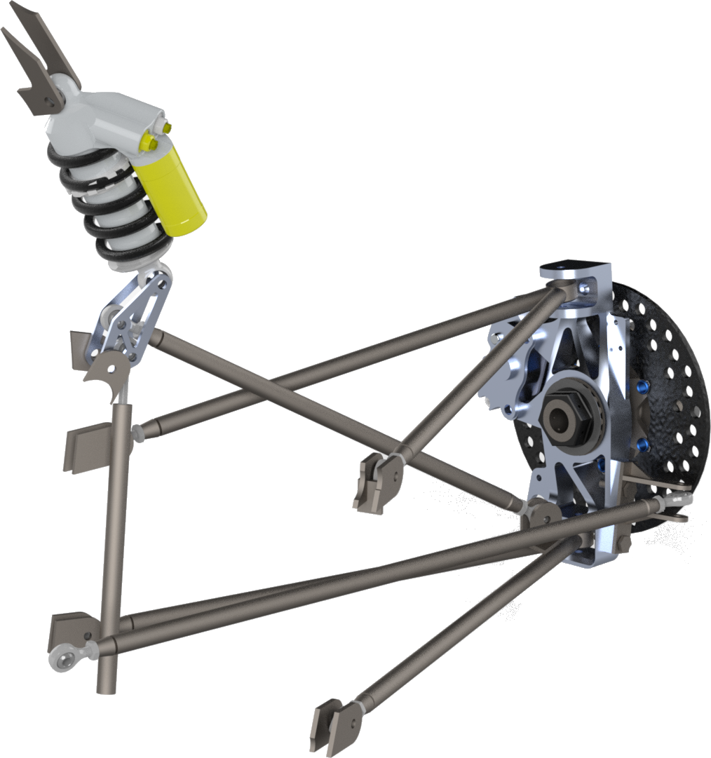
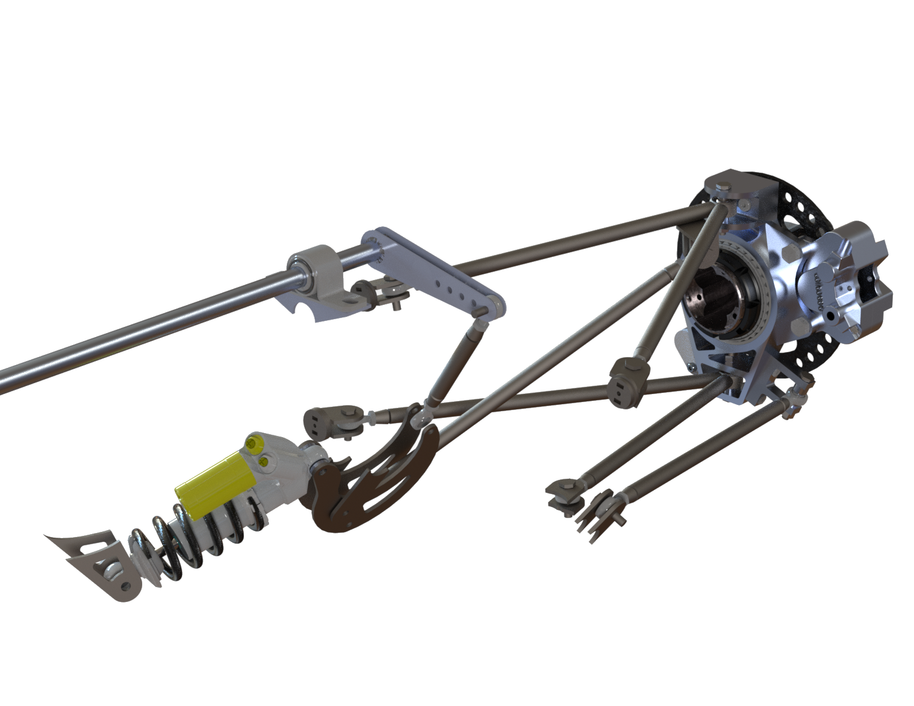
Requirements & Design Criteria
Olin College of Engineering
Perform well in Auto-X and Endurance
Build in adjustability to respond to testing data
Fabrication and assembly are not a bottleneck towards car assembly to provide maximum testing time
Acknowledge lack of past testing data and provide “tuning knobs” in suspension system to provide adjustability
Score well in design
Focus on baseline design from literature with testing procedures to validate non-empirical decisions
Validate the accuracy of CAD to final vehicle to understand intent versus reality

Slide 5
Design Details | System Parameters
Olin College of Engineering
Value | Rationale
Wheelbase: 61” | Minimum is 60”. We want to be as short of a car as possible to reduce MOI and increase maneuverability through turns and chicanes. 61” gives us an inch of allowable error.
Track Width: 50” | Constrained by the physical on-campus manufacturing space. Vehicle needs to be maneuverable in our assembly and storage spaces.
CGH: 10.5” | Based on a high-level CAD assembly
CG F/R Split: 50/50 CG L/R Split: 50/50 | Neutral steer vehicle. We’re confident in our ability to make high level vehicle placements such that there is no front/rear bias of the CG
Total Vehicle Weight with driver: 610 lbs | Based on a measurement of last year’s car and an estimate of weight savings from each subteam
Roll Gradient: 1.5 degrees/g | Based on recommended value from RCVD and talking to industry

Slide 6
Design Details | System Parameters
Olin College of Engineering
Ride & Roll Rates
Suspension Characteristics
Front |  | Rear
Roll Center Height (in) | 3.5 | 4.5
Calculated Ride Rate (lbs/in) | 107.4 | 120.42
Springs Used (lbs/in) | 150 | 200
Roll Rate (no ARB) (in-lbs/rad) | 5.59x10³ | 5.31x10³
Ride Frequency (Hz) | 2.62 | 2.56
Anti Roll Bar Rate (in-lbs/rad) | 5359.19 | 893.4
Front |  | Rear
FVSA Length (in) | 49.5 | 44.05
SVSA Length (in) | 120.4 | 109.7
SVSA Angle | 3.8° | 1.26°
Anti-Dive | 28% | 13%
Caster Angle | 2.97° | 1.65°
Mechanical Trail (in) | 0.54 | 0.25
Static Toe | -1° | -1°
Static Camber | -0.75° | -1°
Front View Spindle Length (in) | 0.84 | 1.5
Side View Spindle Length (in) | 0 | 0

Slide 7
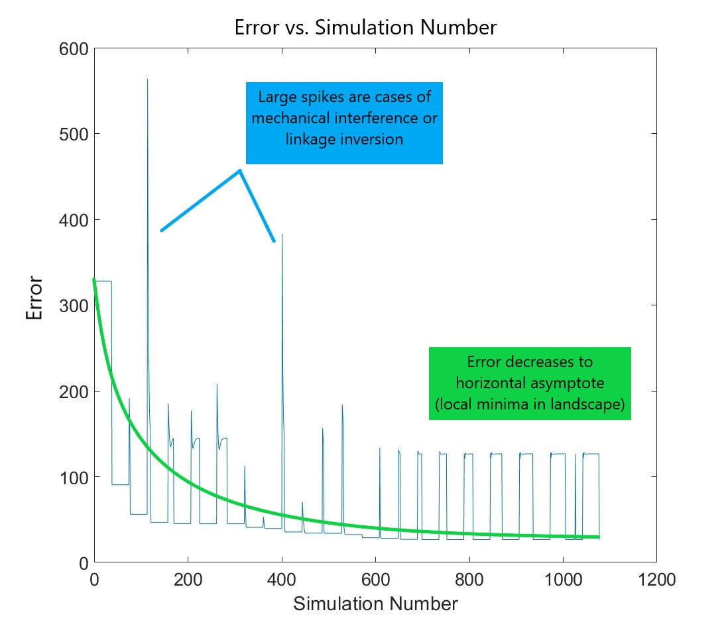
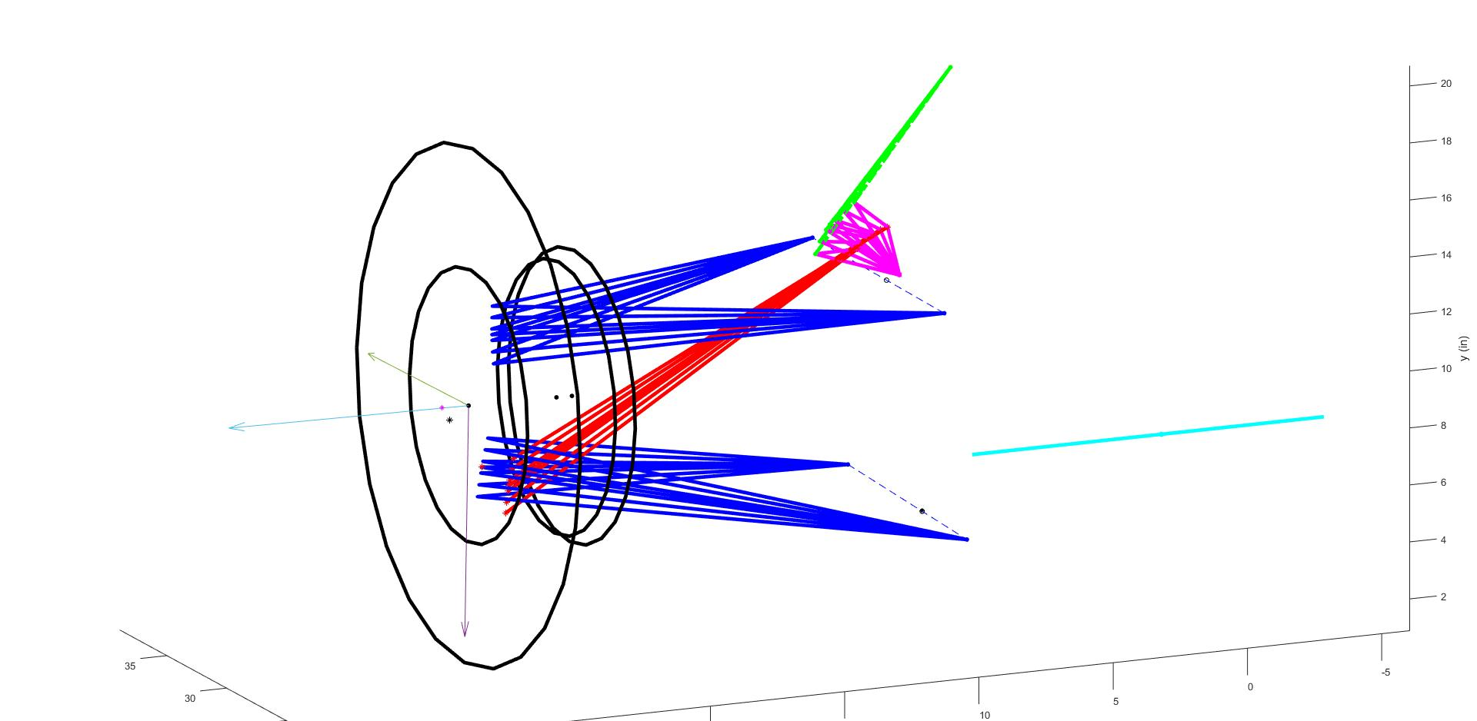
Design Details | Gradient Descent Optimization
Olin College of Engineering
Created a MATLAB script that provides a breadth of suspension geometries that converge to the towards the desired characteristics and geometric constraints. This script minimizes unnecessary CAD guessing and checking with a wider solution space of potential designs.
Notes:
This script determines our suspension nodes when given desired characteristics and constraints. By inputting our designed roll gradient, (what were the constraints, get access to matlab), the outputted members can be seen in the figure.

Slide 8
Design Details | Steering Linkages
Olin College of Engineering
Double wishbone suspension
Rod ends at end of each linkage allow us to change length if needed
Less effect on wheel alignment
Rockers
4130 alloy steel, lightweight
Bushings for precise fit to prevent vibration and reduce friction of bolts connecting to chassis and suspension members
Pull/Push Rods
Rod ends to change length if needed
ARBs
Connected via adjustable lever arm
Lightweight aluminium
Notes:
Why are we using double wishbone, design of rockers?

Slide 9
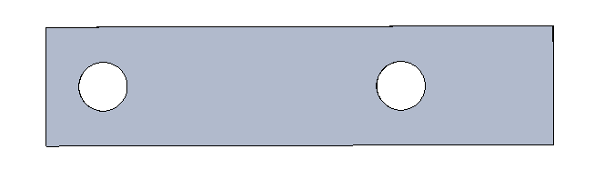
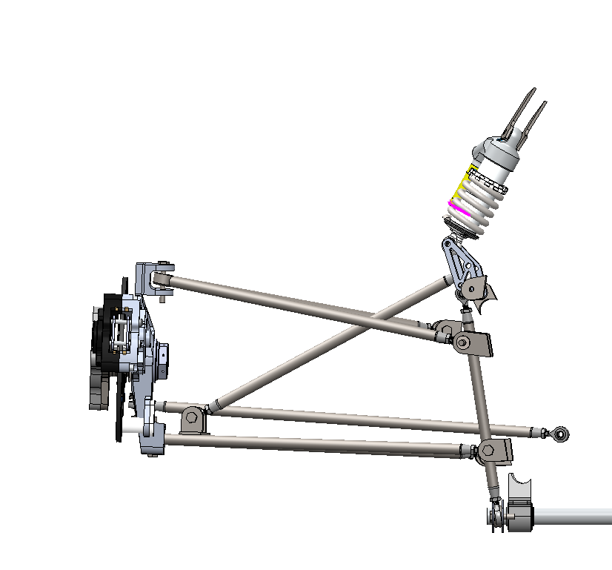
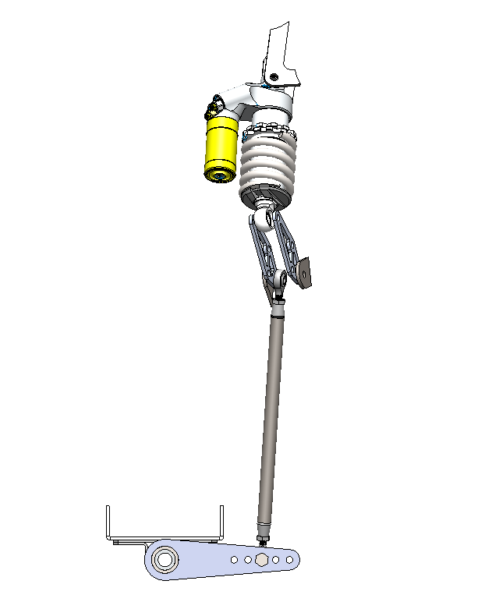
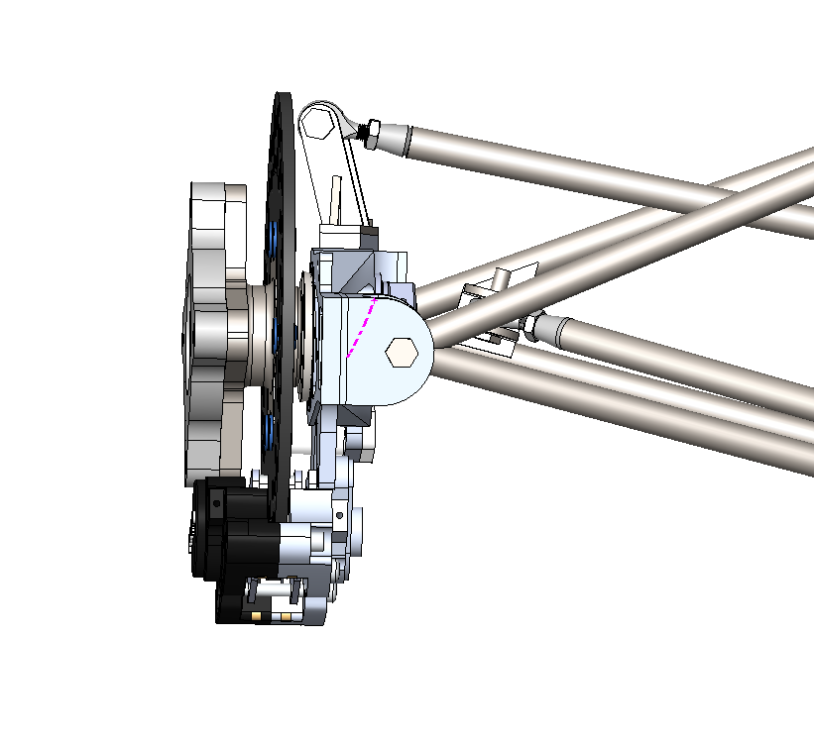
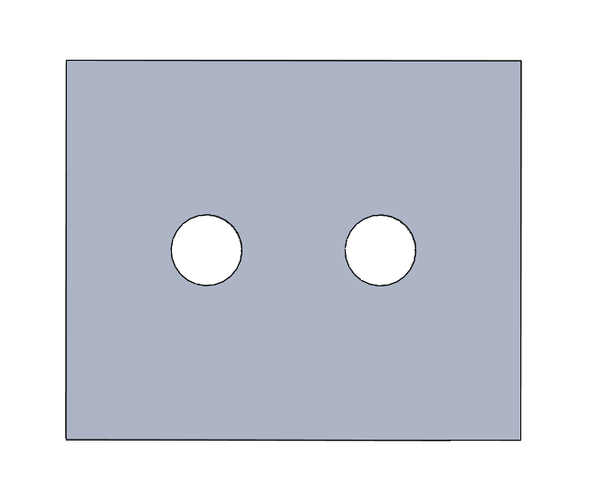
Design Details | Adjustable Camber, Ride Height, Ackermann, Roll Rate
Olin College of Engineering
Ackermann Adj. with Shim
Toe Adj. with Tie Rod Lengths
(Rod end positions)
Ride height adj. with shock pre-load and pushrod length
Camber Adj. with Shim
Roll Rate Adj. with ARB lever-arm positions

Slide 10
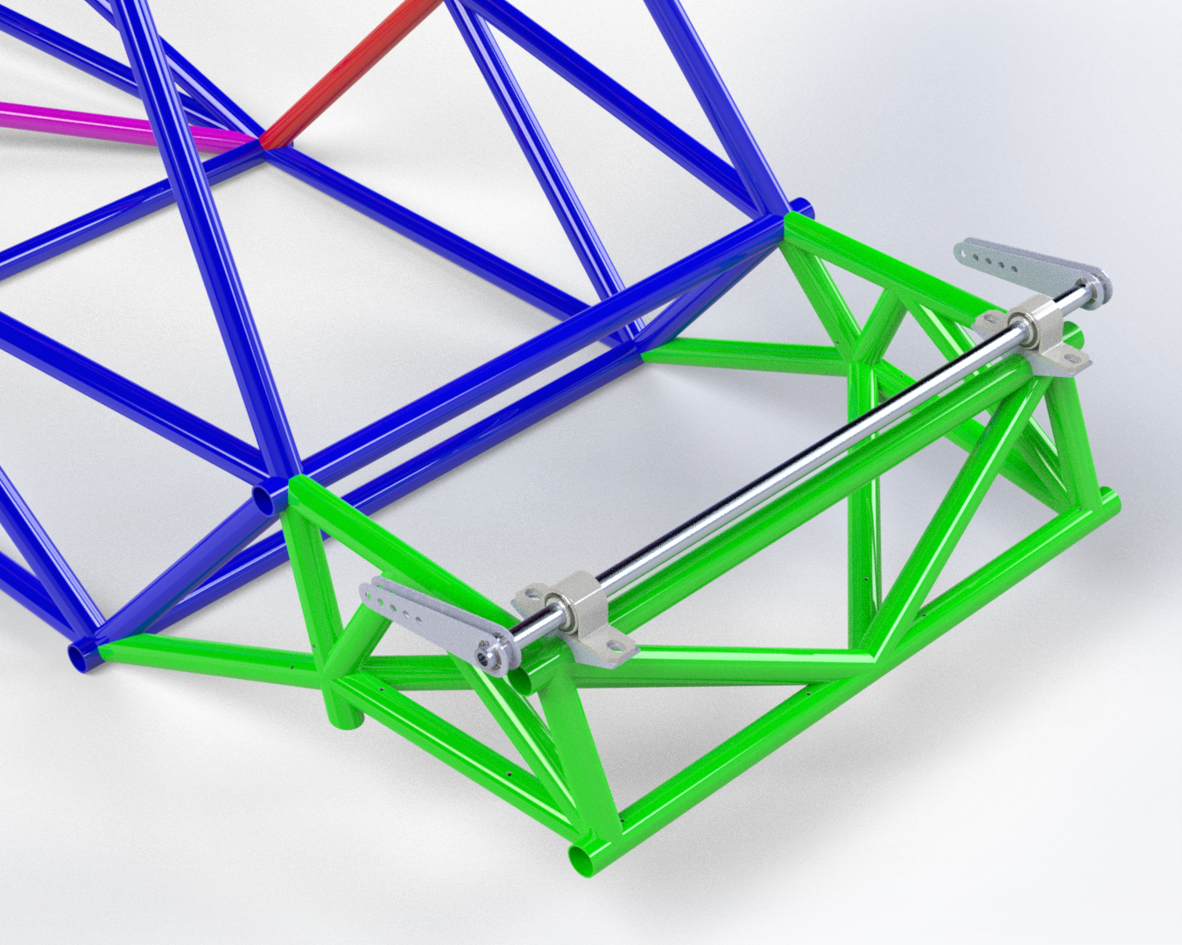
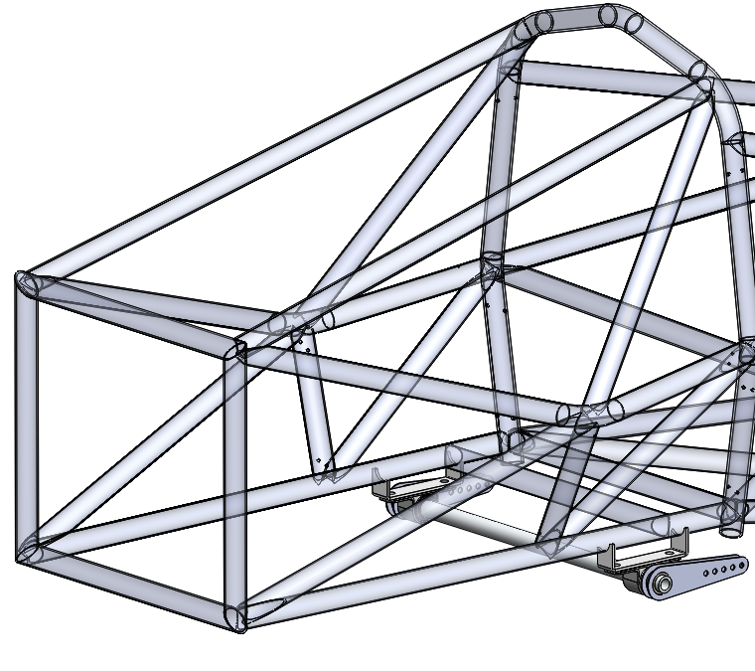
Design Details | Anti-Roll Bar
Olin College of Engineering
Rear ARB
Front ARB
Material | Aluminum 6061
Length (in) | 16.85
Inner Diameter (in) | .5
Outer Diameter (in) | .75
Polar Moment of Inertia (in^4) | 0.025
Torsional Stiffness (in-lbf/rad) | 5577.2
Material | Aluminum 6061
Length (in) | 24
Inner Diameter (in) | .26
Outer Diameter (in) | .5
Polar Moment of Inertia (in^4) | 0.005
Torsional Stiffness (in-lbf/rad) | 893.4
Notes:
Nate -- images with labels, spreadsheet of sizing and bearing stress analysis

Slide 11
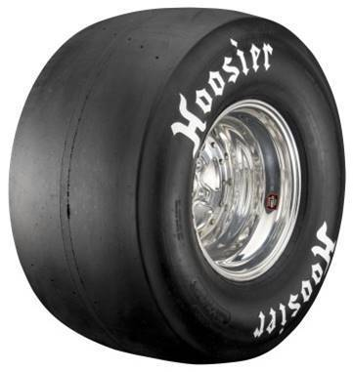
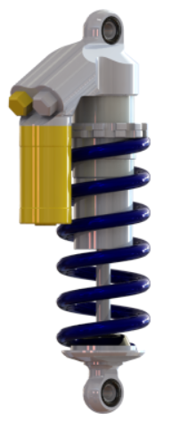
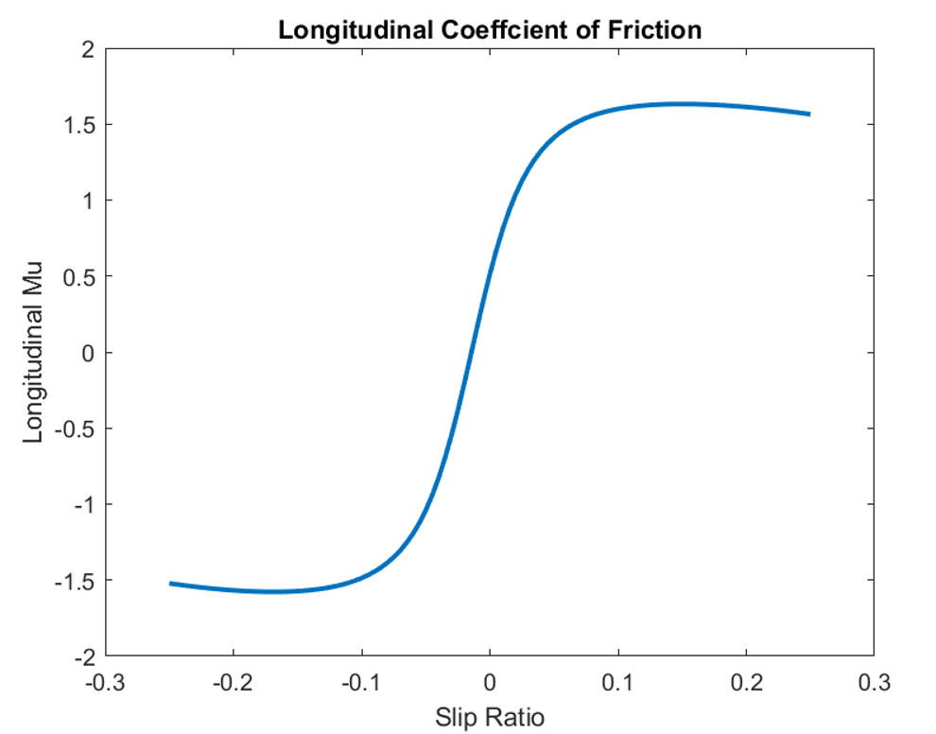
Design Details | Tires and Shocks
Olin College of Engineering
Tires
18x6” Hoosier R25B Tires
Mounted on 7” width rims
Analysis of Tire Testing Consortium data
Shocks
Ohlins TTX 25 Mk.II 50mm
Highly adjustable compression/rebound
Well documented spring rate options
Lightweight and compact
Preloaded so that car sits in the middle of shock travel (with driver sitting inside)
Equal compression/extension room, favoring compression room due to higher likelihood of compression during acceleration/braking

Slide 12
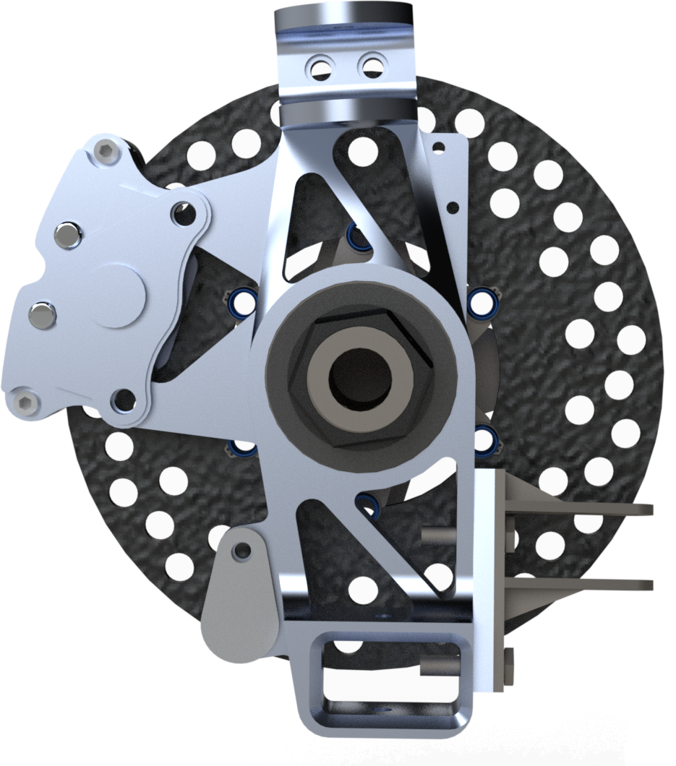
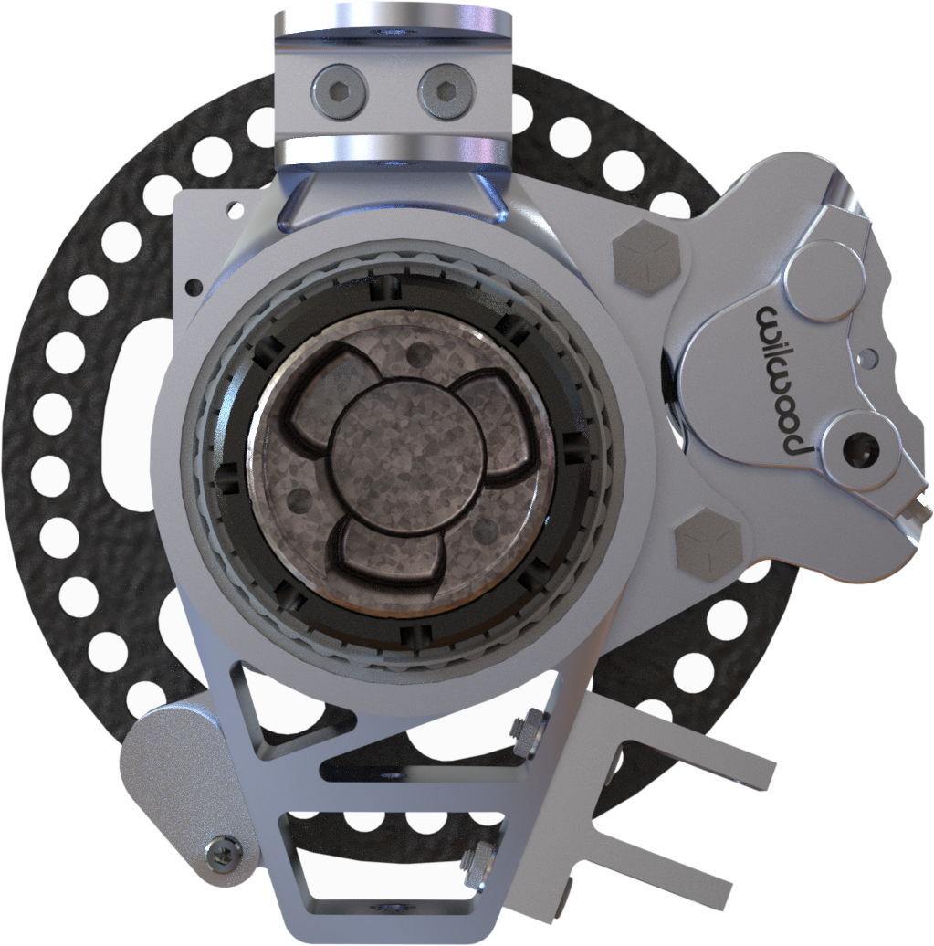
Design Details | Knuckles
Olin College of Engineering
For our knuckles, we tried to lightweight them as much as possible by removing material wherever we could, as well as using aluminium - which we found to be strong enough for our expected loads.
Front Knuckles
Rear Knuckles
Upper A-arm Clevis
Upper A-Arm Clevis
Camber Adjustment Reference
Steering Clevis
Toe Link Clevis
Wheel Speed Sensor
Wheel Speed Sensor
Notes:
Why 6061, are we still having wheel speed sensor

Slide 13
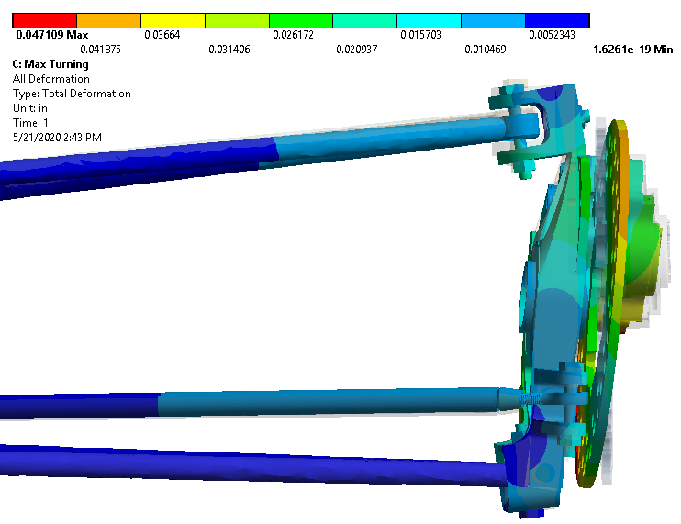
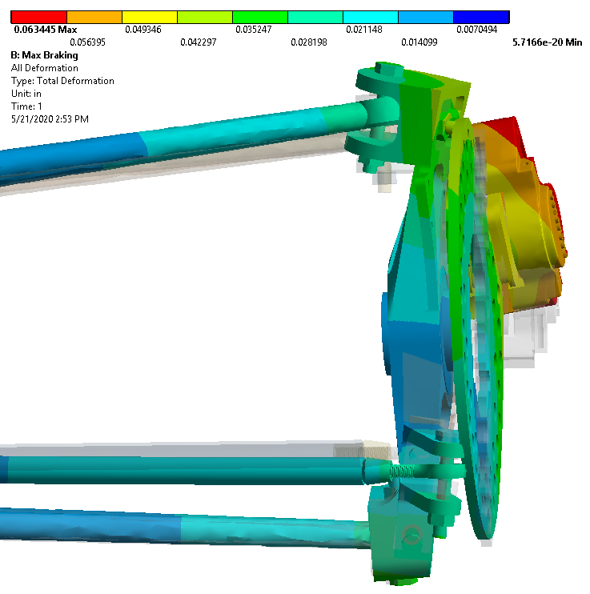
Analysis | Uprights
Olin College of Engineering
Setup and Assumptions
Component interfaces use no-separation contacts
Bolt/nut connections modelled but without preload
Joint connections from A-Arm sphericals to knuckle NAS bolts
A-Arm ends fixed supports
Push rod constraint applied to lower spherical
Two Load Cases
Lateral Tire Loading (Steering) (max used: 600 lbf)
Max weight transfer used: normal force of 250lbf
Longitudinal Tire Loading (Braking)
Front Upright in Turning
Deformation in Braking
No component interference
No unexpected large deformations
Braking force applied to brake pads: 1500 lbf
Deformation in Turning
No component interference
No unexpected large deformations
Front Upright in Braking

Slide 14
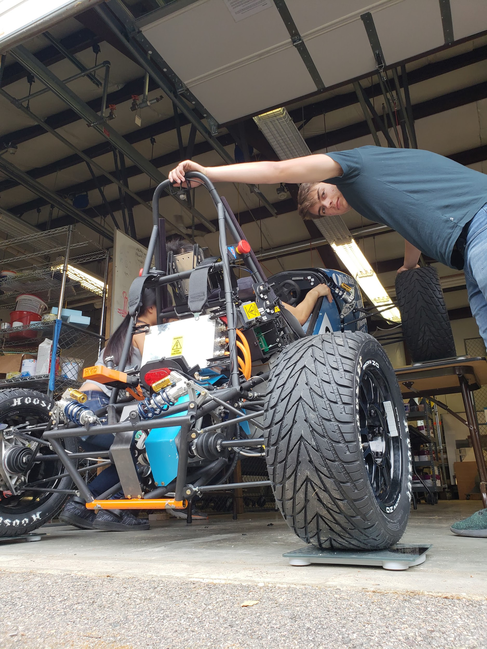
Testing & Validation
Olin College of Engineering
Turning Radius
Marked out 9m turn to test whether our car could complete skidpad testing
Found that car has turning radius of 6.5m, which gives us room to make desired changes to steer ratio or clevises
Center of Mass Testing
Replace shocks with rigid stand-ins, weigh 4 corners on flat ground, weigh 4 corners when tilted
Calculate COM, compare with estimated COM and adjust ARB stiffness accordingly
Over/Understeer Testing
Constant steer input with increasing velocity, measure acceleration and steering input when traction is lost
Validate assumptions on the limits of the friction circle of the tires
Adjust ARB stiffnesses to change turn-in/turn-out weight transfer rates

Slide 15
In-House vs Off-site Considerations
Olin College of Engineering
Our in-house fabrication includes:
Suspension members (control arms, a-arms, steering/toe link rod)
Anti-roll bar assembly
Welding jigging and tooling for installation and assembly
The team aims to provide as many machining opportunities for members wherever possible. We believe strongly in the learnings that can come from an engineer seeing the full design and fab cycle to improve upon future iterations.
Our off-site fabrication includes:
Chassis (machined & welded by VR3)
Uprights (machined by DATRON)
We look to outsource components whose learning outcomes are far less than the number of hours needed to make do with our on-campus facilities. This choice is always a balancing act, but maintains the right balance to help prepare members for the challenge of designing a vehicle the following year.

Slide 16
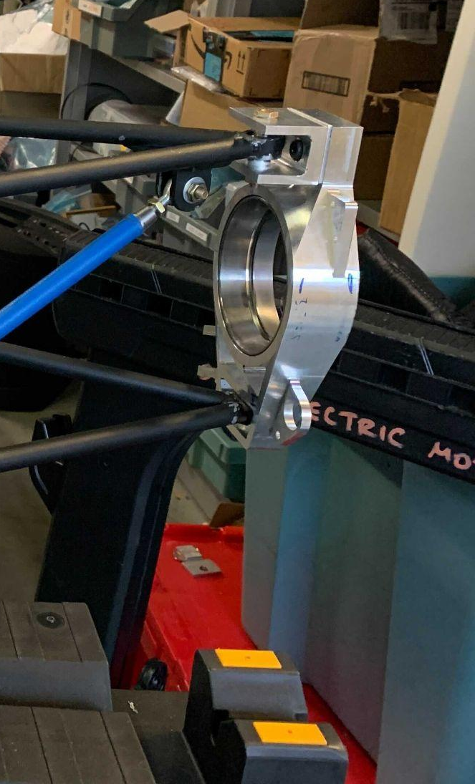
Congruence of Assemblies to Design Intent
Olin College of Engineering
Upon completing our suspension assembly, we found that although we were able to fully assemble the system, our numerous varying spacers and fasteners made it difficult to quickly and accurately replicate our design in CAD:
Spacer assemblies between tabs proved to be very difficult due to tight tolerances
We used washers when the correct fastener or spacer could not be found
We found interference between a bolt head and suspension member, which resulted in a front rocker plates redesign
This was due to a design oversight of a senior member who graduated during COVID – as a result, the new engineers who oversaw the assembly process had to figure out a re-design

Slide 17
Successes & Failures
Olin College of Engineering
The major theme of our suspension system for Mk.5 was reducing unnecessary busy work to provide more opportunities for testing and to better make use of our engineers’ most valuable resource, time. In many ways this goal was successful through the implementation of the suspension geometry optimization script and the local jigging of inboard suspension tabs. This was clear through major fabrication and assembly goals being hit a month earlier than any previous vehicle. We were able to produce a working suspension system with little to no previous testing data, instead relying on literature and past driving and fabrication experience.
However, the pandemic affected the pace of completing the vehicle that negated any timeline gains in our fabrication phase. This has lead to hard learnt lessons in documentation and knowledge transfer as our original intent for testing has been largely tabled. We also did not have the opportunity to formally test our assembled suspension system. Fabrication of suspension components took longer than anticipated. In the future, standardizing spacers and fasteners would greatly help reduce production time.

Slide 18
Frame | Body | Aero
Olin College of Engineering

Slide 19
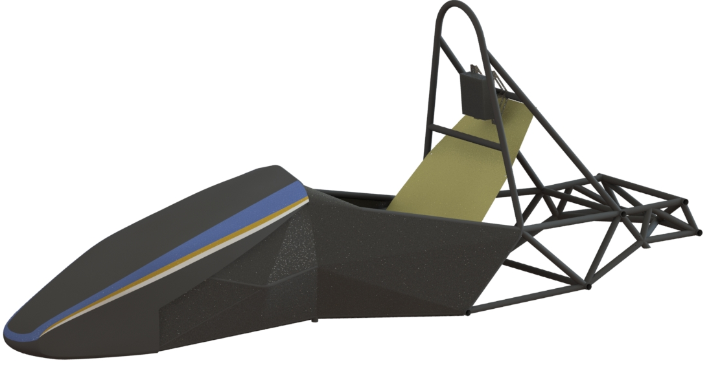
Overview & Concept of Operations
Olin College of Engineering
Frame
Designed to allow for easier suspension welding
Sent out to VR3 for fabrication & welding
Body
Firewall is aluminum & garolite
Floor closeout is aluminum
Airframe fabric used as body paneling
Aero
Nose cone is carbon fiber, sent out to a local composite shop for fabrication
No other aero package
Firewall
Airframe Fabric
Nose Cone
Chassis
Floor Closeout

Slide 20
Requirements & Design Criteria | Frame
Olin College of Engineering
Be a strong contender at competition
Focus on scoring well in autocross (performance) in endurance (reliability)
Frame is not a timeline bottleneck
Accommodate tuning/testing/driver practice
Score well in design
Perform rigorous analysis to optimize frame structure for packaging, ergonomics, weight, and MOI
Design changes from Mk.4
Changed from global welding jig to local welding jig
Sped up timeline by more than 2 months
Performed tube study to have an optimized pipeline for frame structural analysis
Changed cockpit design to increase driver comfort and accommodate all drivers in the team

Slide 21
Requirements & Design Criteria | Body
Olin College of Engineering
Be a strong contender at competition
Score well in static events (design presentation)
Body covering looks polished and professional
Perform paint and livery tests early
Design criteria
Have reliable and robust bodywork
Body panels should be strong and well secured
Bodywork should be easy to install/remove and repair
Decrease stress of manufacturing bodywork
Improve manufacturing processes and materials
Perform unit tests early
Firewall
Airframe Fabric
Nose Cone
Floor Closeout

Slide 22
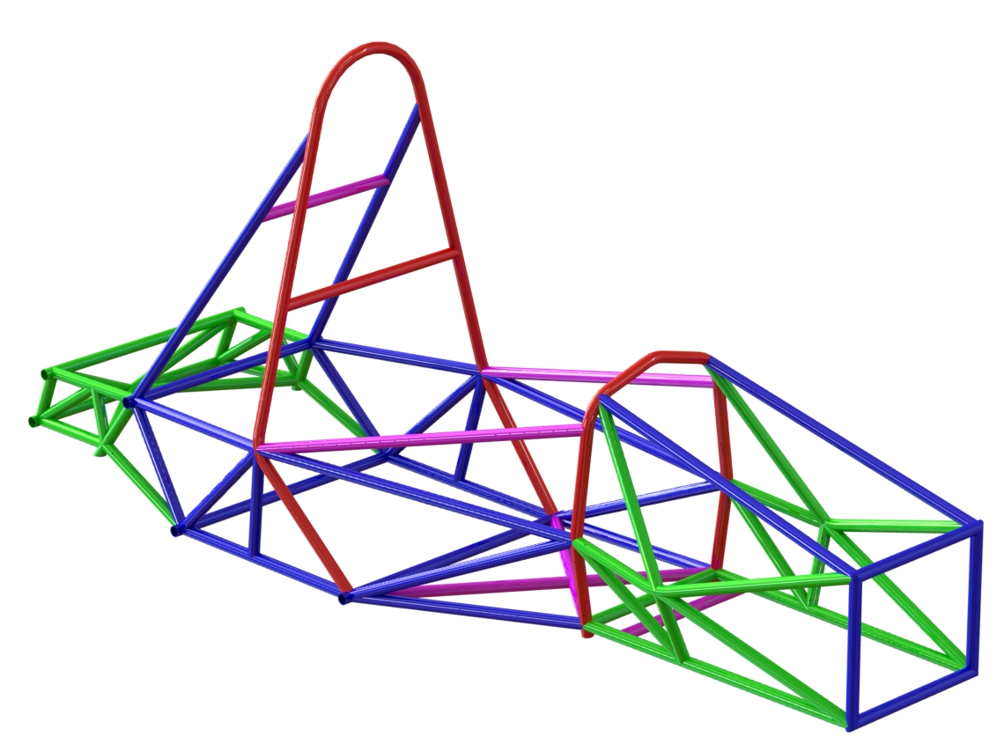
Design Details | Frame
Olin College of Engineering
Welded by VR3 (commercially)
63.39 lbs (3.5% saved from Mk.4)
47810 lbs*in² yaw moment of inertia (5% saved from Mk.4)
1.000” OD x .095” WALL
1.000” OD x .065” WALL
1.000” OD x .049” WALL
1.000” OD x .035” WALL

Slide 23
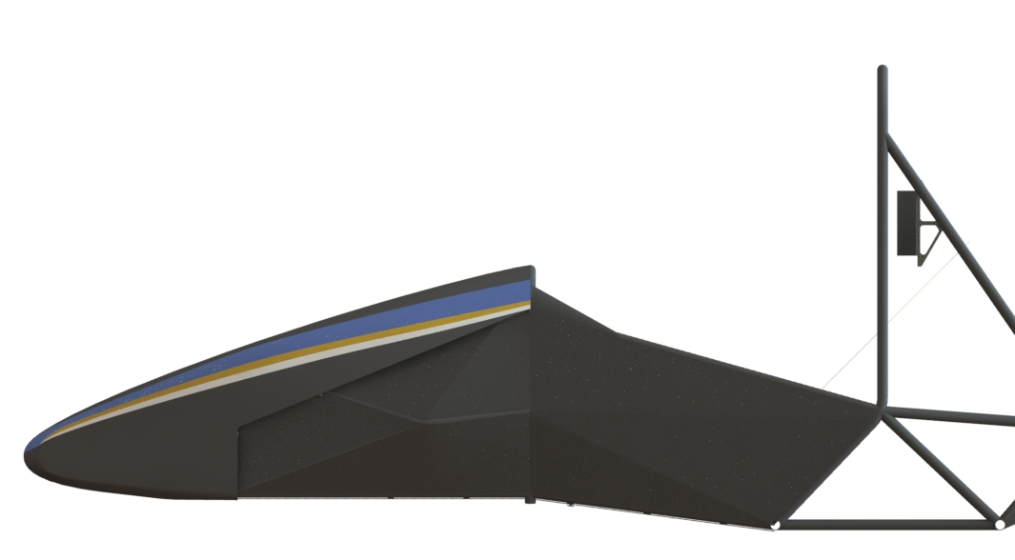
Design Details | Body | Airframe Fabric
Olin College of Engineering
Oratex® Aircraft Fabric replaces the composite side body panels
Reduces labor by 145 man hours (design and manufacturing)
Reduces cost by $600
Reduces weight by 0.2 kg
Enables quick field repairs
Heat activated adhesive means that installation only requires a heat-gun

Slide 24
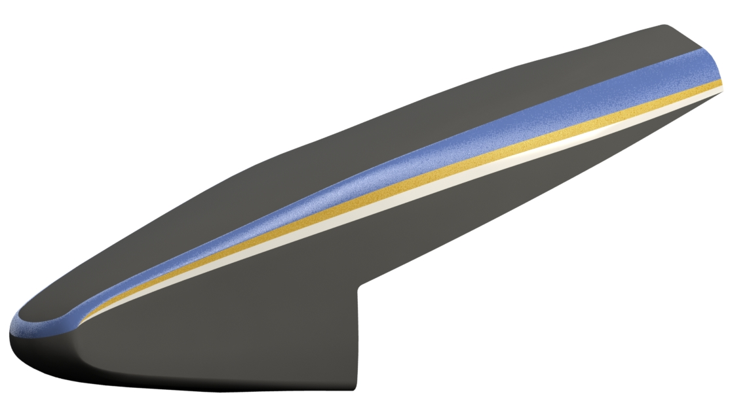
Design Details | Body | Nosecone
Olin College of Engineering
Carbon fiber body panel to provide improved aerodynamic shape at front of vehicle
Improved geometry to ease mold manufacturing and layup
Quick to install/remove with sidewalk bolts
Easy access to cockpit

Slide 25
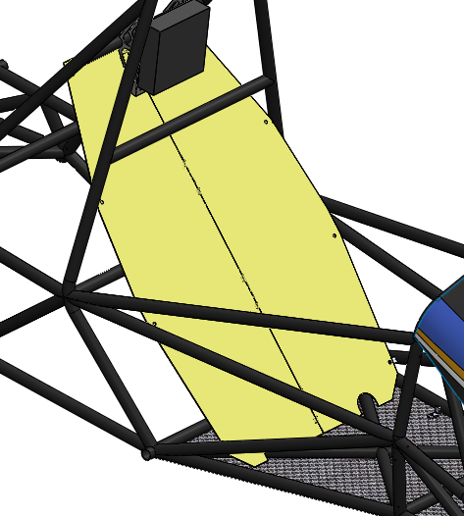
Design Details | Body | Firewall
Olin College of Engineering
Two panel design
Bends in one direction when free using plastic hinges
Rigid when bolted in chassis using nylon nuts and bolts
Improved installation and removal
This part must be removed frequently as part of accumulator installation / removal
Two panel design allows the firewall to be maneuvered easier in the limited space within the chassis
This reduced time required to install / remove the firewall.
Materials
1/32” Garolite G-10 on driver side, seam sealed with Kapton tape
1/40” Aluminum on tractive system side, seam sealed with aluminum tape
West Systems 105 Epoxy for bonding all parts

Slide 26
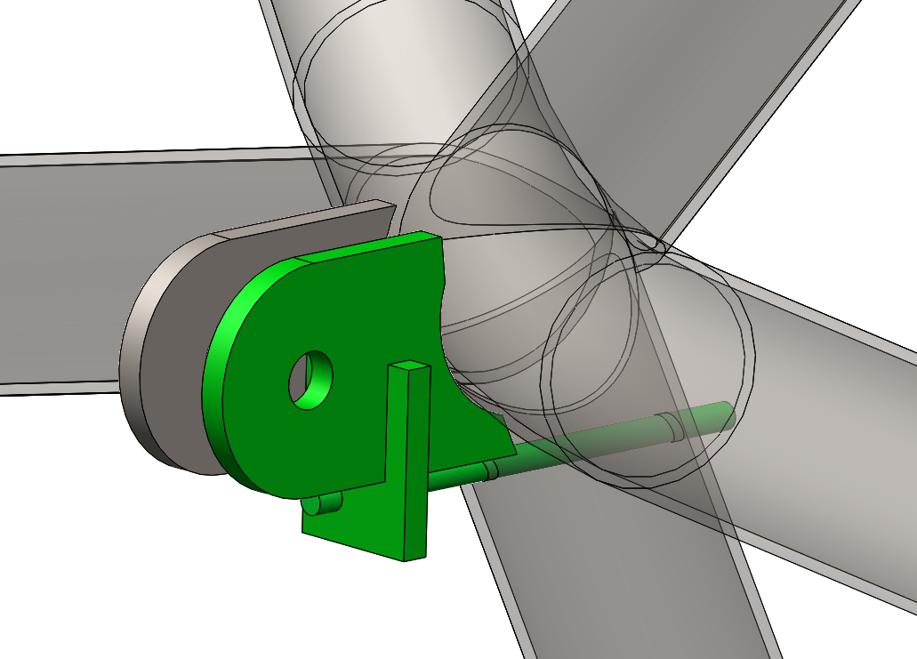
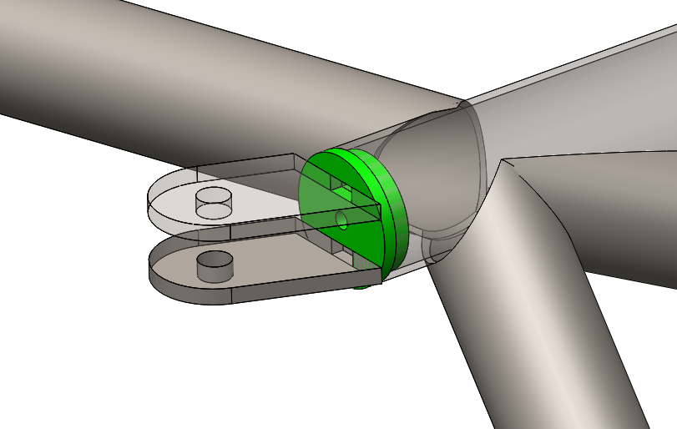
Assembly & Manufacturing | Frame
Olin College of Engineering
Chassis tabs welded in house using local jigs
Local jigging chosen over global
Not every component needs to be complete to begin welding
Reduced setup and take down time
Measurements indicate no reduction in accuracy
Suspension welding used plug tabs and sacrificial tab jigs
Reduced welding time from 40 to 25 hours
By utilizing plug welds, we were able to make suspension welding much easier as we only had to constrain one degree of freedom rather than six
Increased accuracy of suspension tab placement with locating features from the chassis nodes themselves

Slide 27
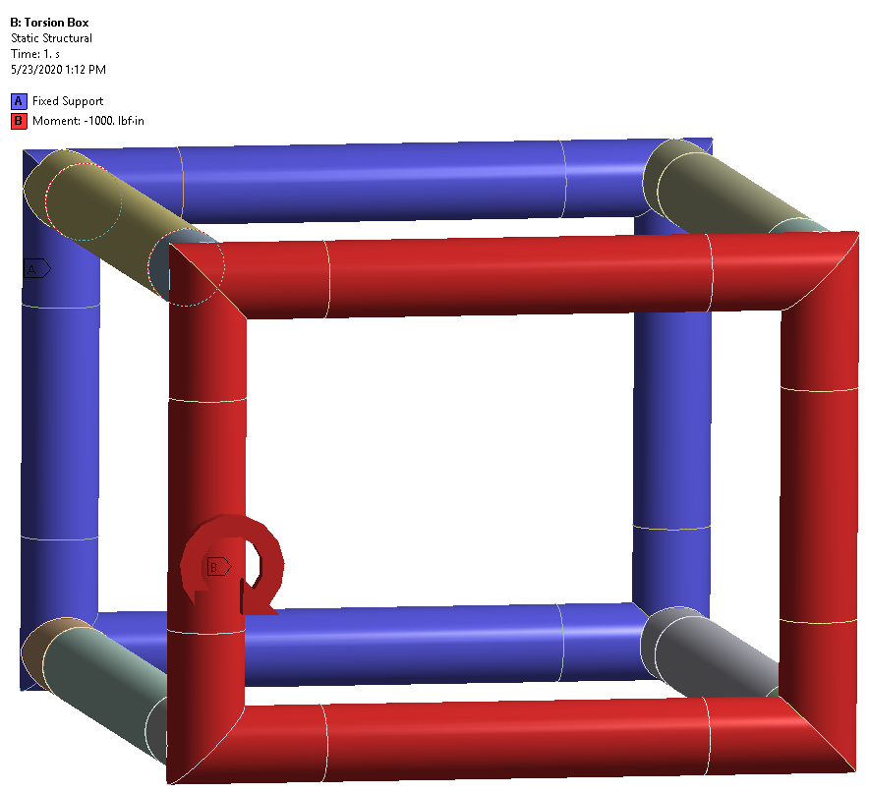
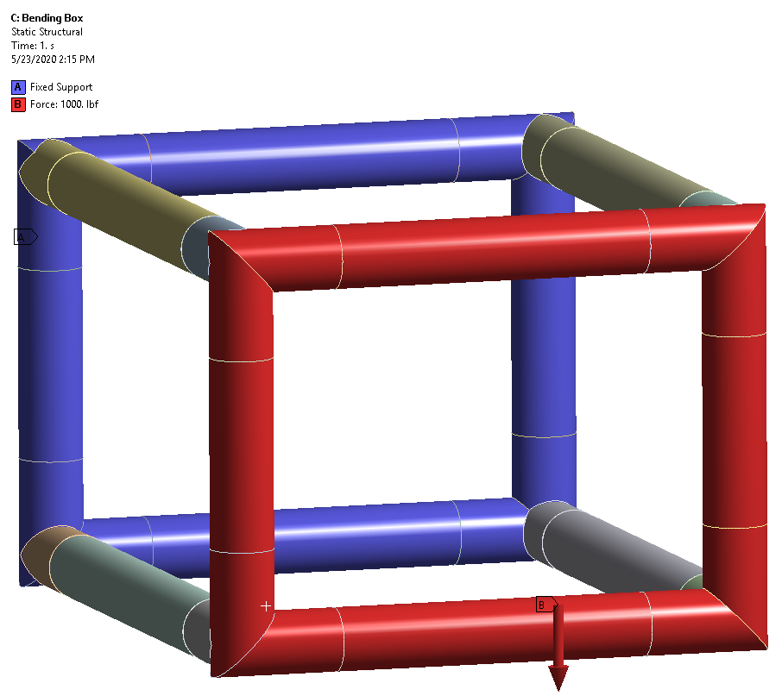
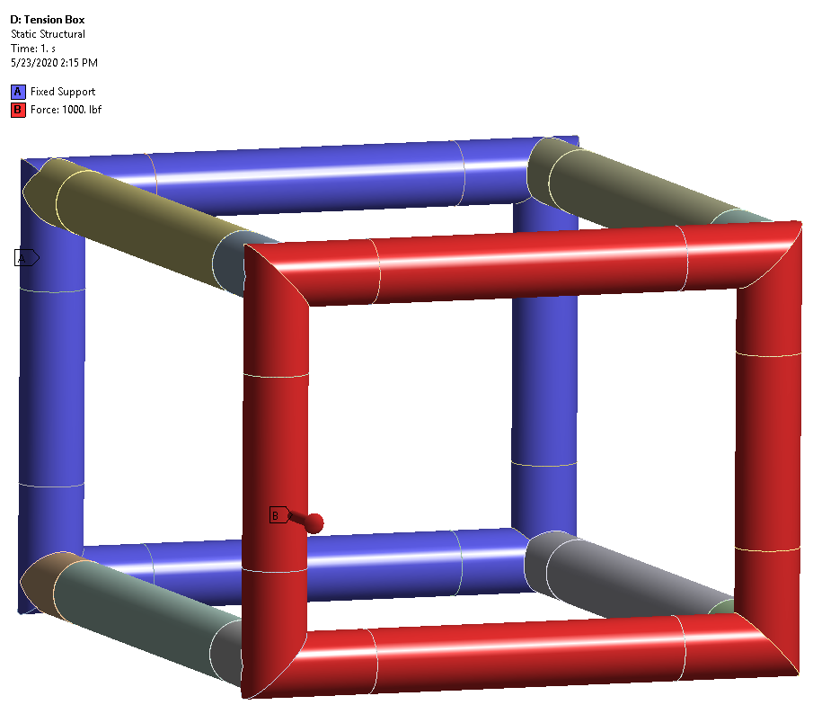
Analysis | Frame | Tube Study
Olin College of Engineering
Goal
Evaluate relative stiffness, accuracy, and speed of split meshing vs beam elements for the purpose of analyzing various sections of the chassis.
Major assumption
Study assumes that high density mesh analysis is the most accurate relative to reality

Slide 28
Analysis | Frame | Tube Study
Olin College of Engineering
Results
The results of the three load cases showed that using beam elements to analyze the deformation of a multi-tube structure produces significantly stiffer results.
Beam elements were:
20% stiffer in the torsion study
25% stiffer in the bending study
40% stiffer in the tension study
For the torsional study of the chassis we used beam elements because they allowed for quick iteration. For smaller sections of the chassis we used the split mesh method to do more in-depth analysis about relationships between tubes.

Slide 29
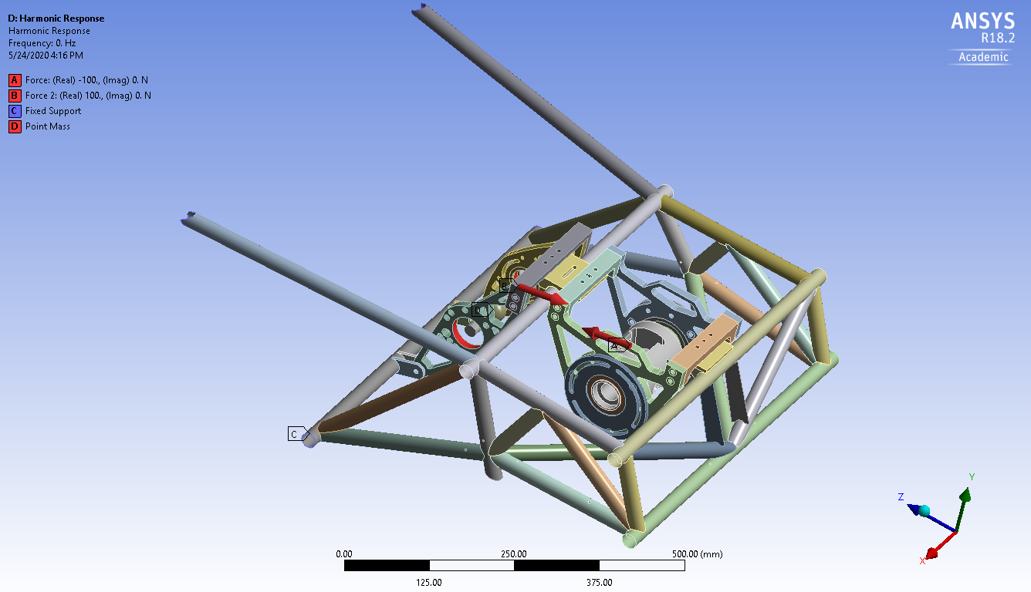
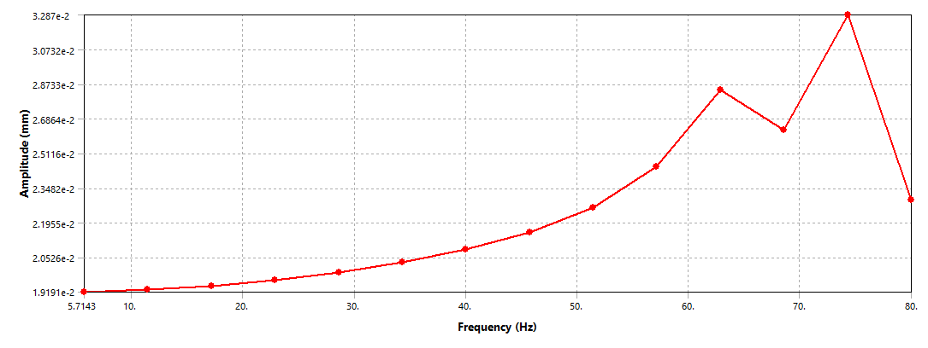
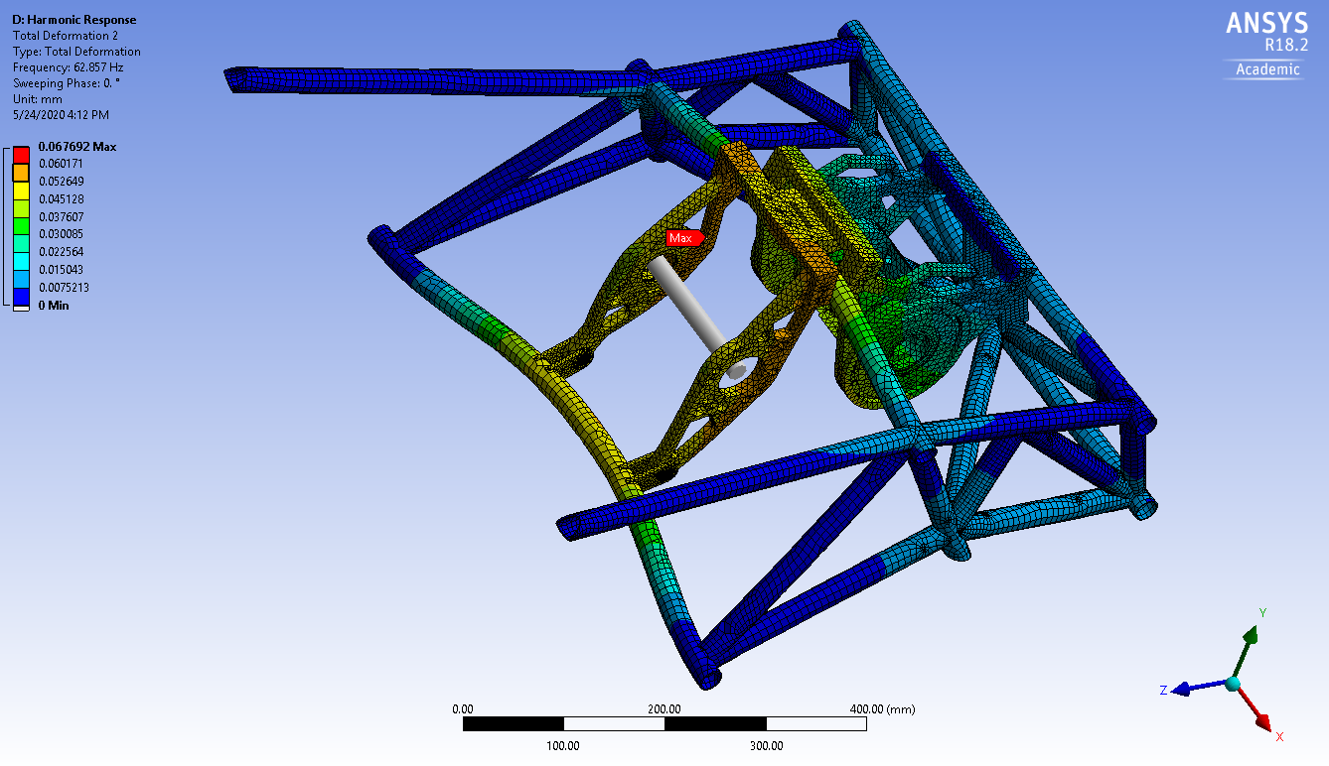
Analysis | Frame | Rear Box Modal Analysis
Olin College of Engineering
Maximum Emrax speed is 4500 rpm (75 Hz)
Amplitude peak is at top motor speed
Implies the need for motor plate stiffening, which was implemented in the final assembly

Slide 30
In-House vs Off-site Considerations | Frame
Olin College of Engineering
Our chassis was welded by VR3.
Out of house was chosen given our limited access to welding resources
Only one large welding bay at the school, not feasible to do the entire chassis due to frequent setup and take down
We did not weld tabs, but had VR3 drill holes marking locations for suspension jigging
Low cost addition since they were already making it, significantly reduced time in weld bay

Slide 31
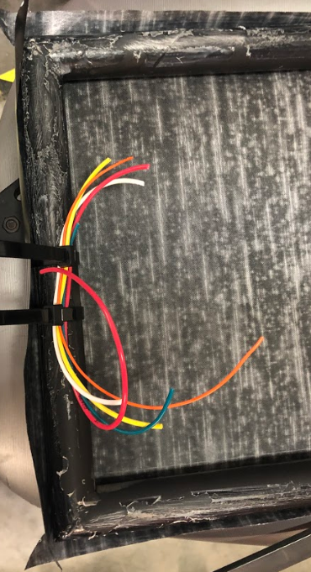
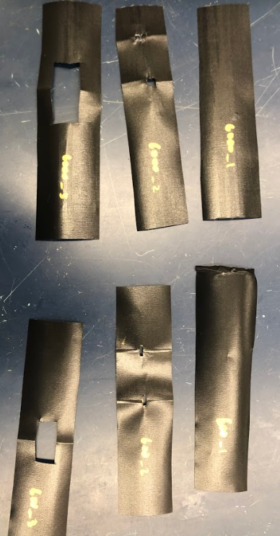
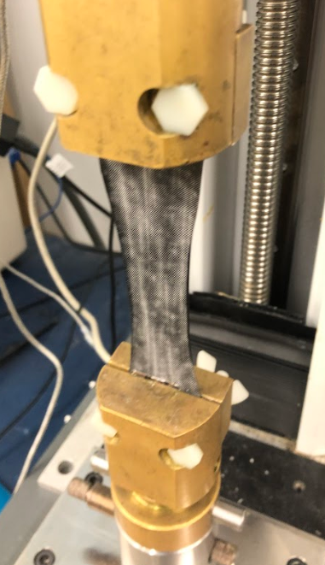
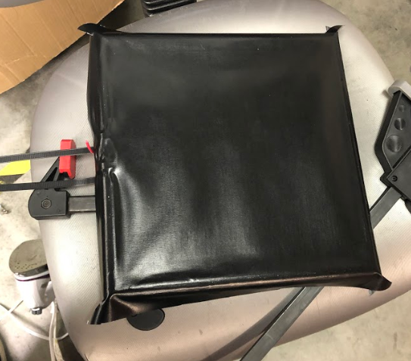
Test | Body | Airframe Fabric
Olin College of Engineering
Airframe fabric was tested on sample part of chassis with ‘wire harness’
Tested painting and vinyl application for livery
Pieces with and without holes were pulled on the Instron
There started to be slight deformation of the fabric around 100 N in all samples

Slide 32
Congruence of Assemblies to Design Intent
Team Number #236
Olin College of Engineering
Airframe Fabric
Because body coverings were installed prior to front suspension installation due to the permanence of airframe fabric installation, it made applying fabric in these areas especially difficult to deal with. In CAD, a significant amount of front suspension members were protruding through the body covering plane. During fabric installation, the fabric had to be trimmed and placed around these members, making the final appearance of the body covering in these areas different from design intent (see also Failures in Successes & Failures slide).
Chassis
Since we shipped this out for manufacturing, our design was fabricated and welded according to our CAD. The only change we made was adding two vertical tubes to either side of the accumulator due to a new rules update about mounting requirements in 2022.

Slide 33
Successes & Failures
Team Number #236
Olin College of Engineering
Successes
The implementation of airframe fabric body covering saved a significant amount of labor hours in design & fabrication compared to body panels. Even given it was the team’s first time using it, it looks professional & visually pleasing
Two-panel firewall design was a major upgrade over the single panel design in previous car iterations. Removing / installing the firewall only takes a few simple maneuvers and is significantly more comfortable to perform but still just as rigid when mounted.
Failures
The permanence of the airframe fabric as a body covering made it difficult to make changes to and work around. Applying the fabric around front suspension members was especially difficult & usage of body panels on these areas of the chassis that need to be serviced frequently would be preferred. Perhaps a fabric / body panel hybrid can be used in future designs
We failed to have a nose cone made for our team in a timely manner. As a team we usually purchase our nose cone due to limited shop resources. Working with our typical composites vendor this year presented a number of unique communications challenges that lead to delays in our nose cone manufacturing.

